Slide 1
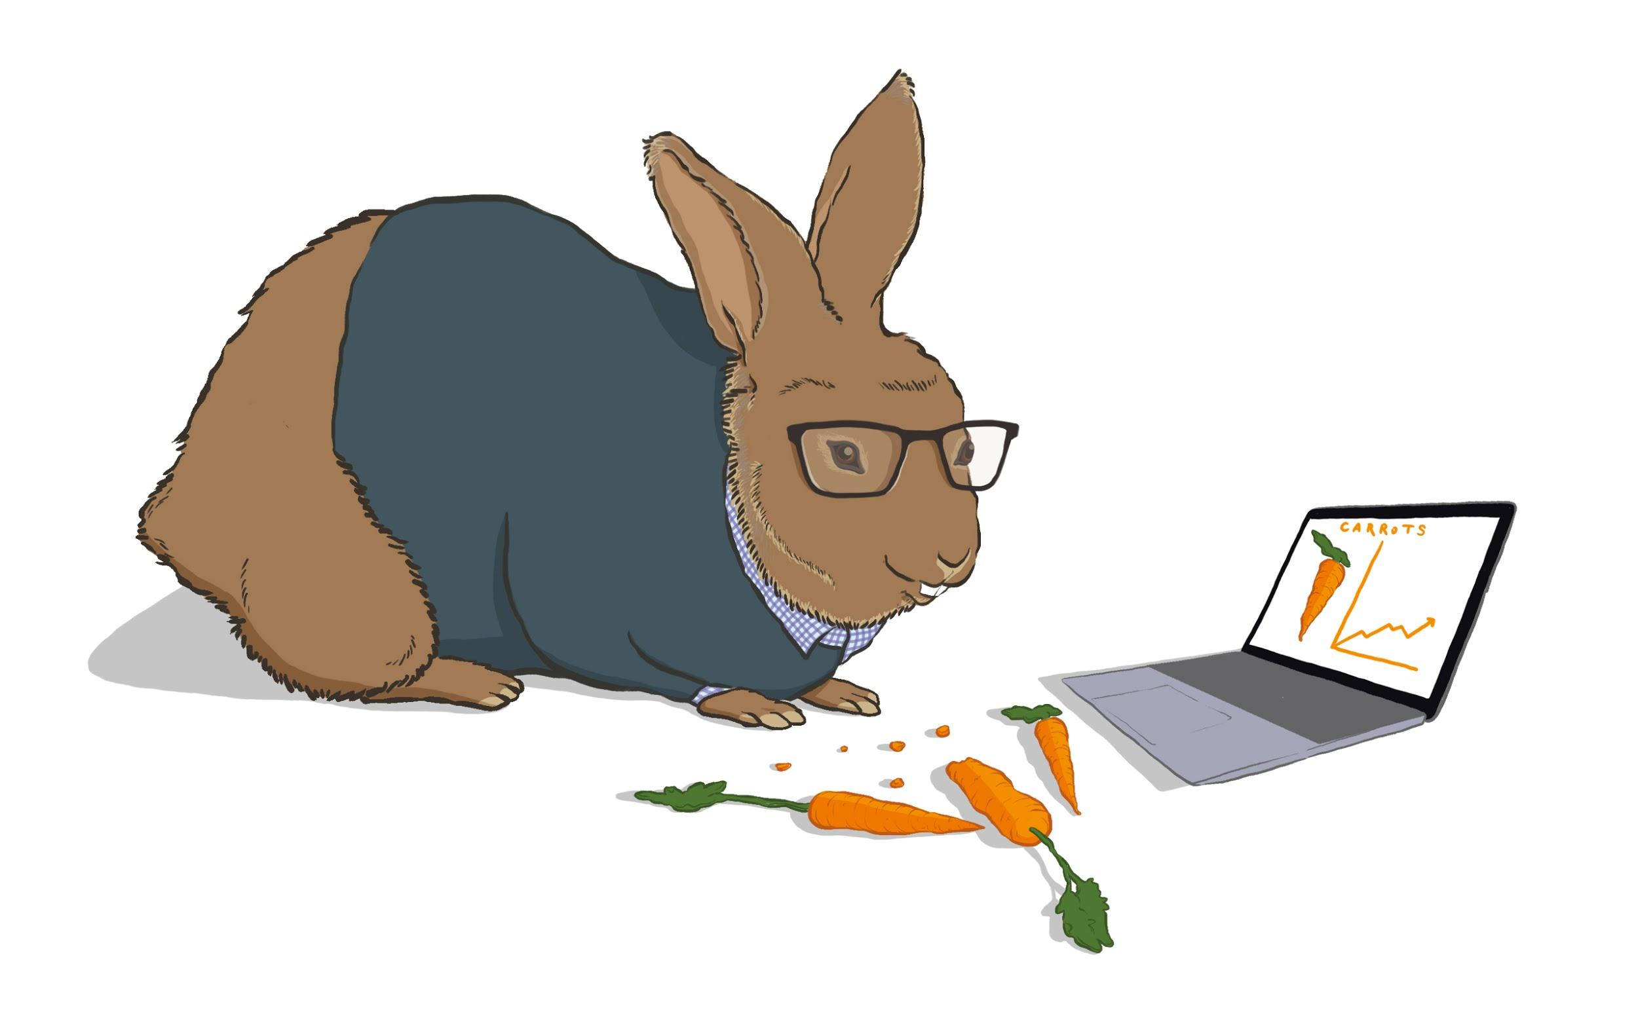
The Data-Driven Communicator:
A Crash Course in Social Listening, Analyzing Brand Voice, Understanding Sentiment, and More...
Alexander Rose
Assc. Manager, Data Analytics
Notes:
Thanks for joining me today. During our time together, I hope to identify some of the challenges that are inherent to working with unstructured text data and provide with a few tools to help you cope with those challenges.
Let’s dive in!

Slide 2
$105+ Billion
Source: Research and Markets via prnewswire.com “The Global Big Data Analytics Market, 2027: A $105+ Billion Opportunity Assessment”
Notes:
Data analytics has become very big business. In a few years time it is estimated that we will spend north of 105 Billion dollars annually on data analytics.

Slide 3
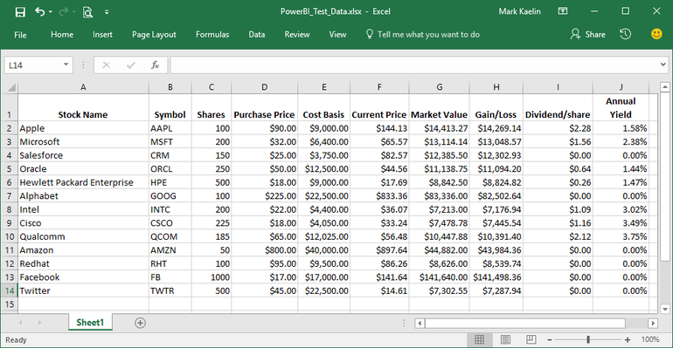
When you hear the words ‘raw data’ what image comes to your mind?
Source: TechRepublic, “How to configure an Excel file for use in Power BI”
Notes:
When you think of Raw Data, what image comes to your mind?
**Pause**
For many of you that image probably looked something like this.

Slide 4
How much data do we generate every day?
4PB Content on FB
500M Tweets
Will that fit in a spreadsheet?
65BN Msgs on WhatsApp
Notes:
Therein lies the challenge. Many of us have gained some skill analyzing tabular data. But we, as humans, generate a lot of data every day. In fact every single day we generate:
4 petabytes (that’s 4000 terabytes) of data that is uploaded to facebook.
500M Tweets are published
& 65 Billion Messages are sent on WhatsApp
Is a spreadsheet enough?
It’s pretty obvious the answer is, “No!”
I’m not trying to starting a tooling debate.
I love excel and use it virtually every day, but my concern is that we are so used to thinking of data in a tabular form, that we overlook all of the unstructured data that is available to us because it would take too long for us to derive meaningful insight from it.

Slide 5
Who is this lightning talk for?
If you’ve asked yourself:
How do I know if my branded social accounts stand out?
How do people feel about my brand? What do they say about it?
How do I make sense of all of the data we collect through social listening?
Term Freq. & Correlation
Sentiment Analysis
N-grams & Conversation Mapping
Notes:
That begs the question, who is this talk for
If you’re starting to think about unstructured data, particularly text, and you’ve asked yourself:
How do I know if my branded social accounts stand out?
How do people feel about my brand? What do they say about it?
How do I make sense of all of the data we collect through social listening?
Then you’re in the right place.
I’ll give you a quick survey of some of the tools that you can use to answer these questions.
For questions on brand voice, we’ll look at Term Frequency and Correlation
For conversation mining, we’ll look at sentiment analysis
And for mid to high velocity social listing, we’ll look at n-gram analysis and conversation mapping.
We’re going to do that by looking at the free-trading app Robinhood.

Slide 6
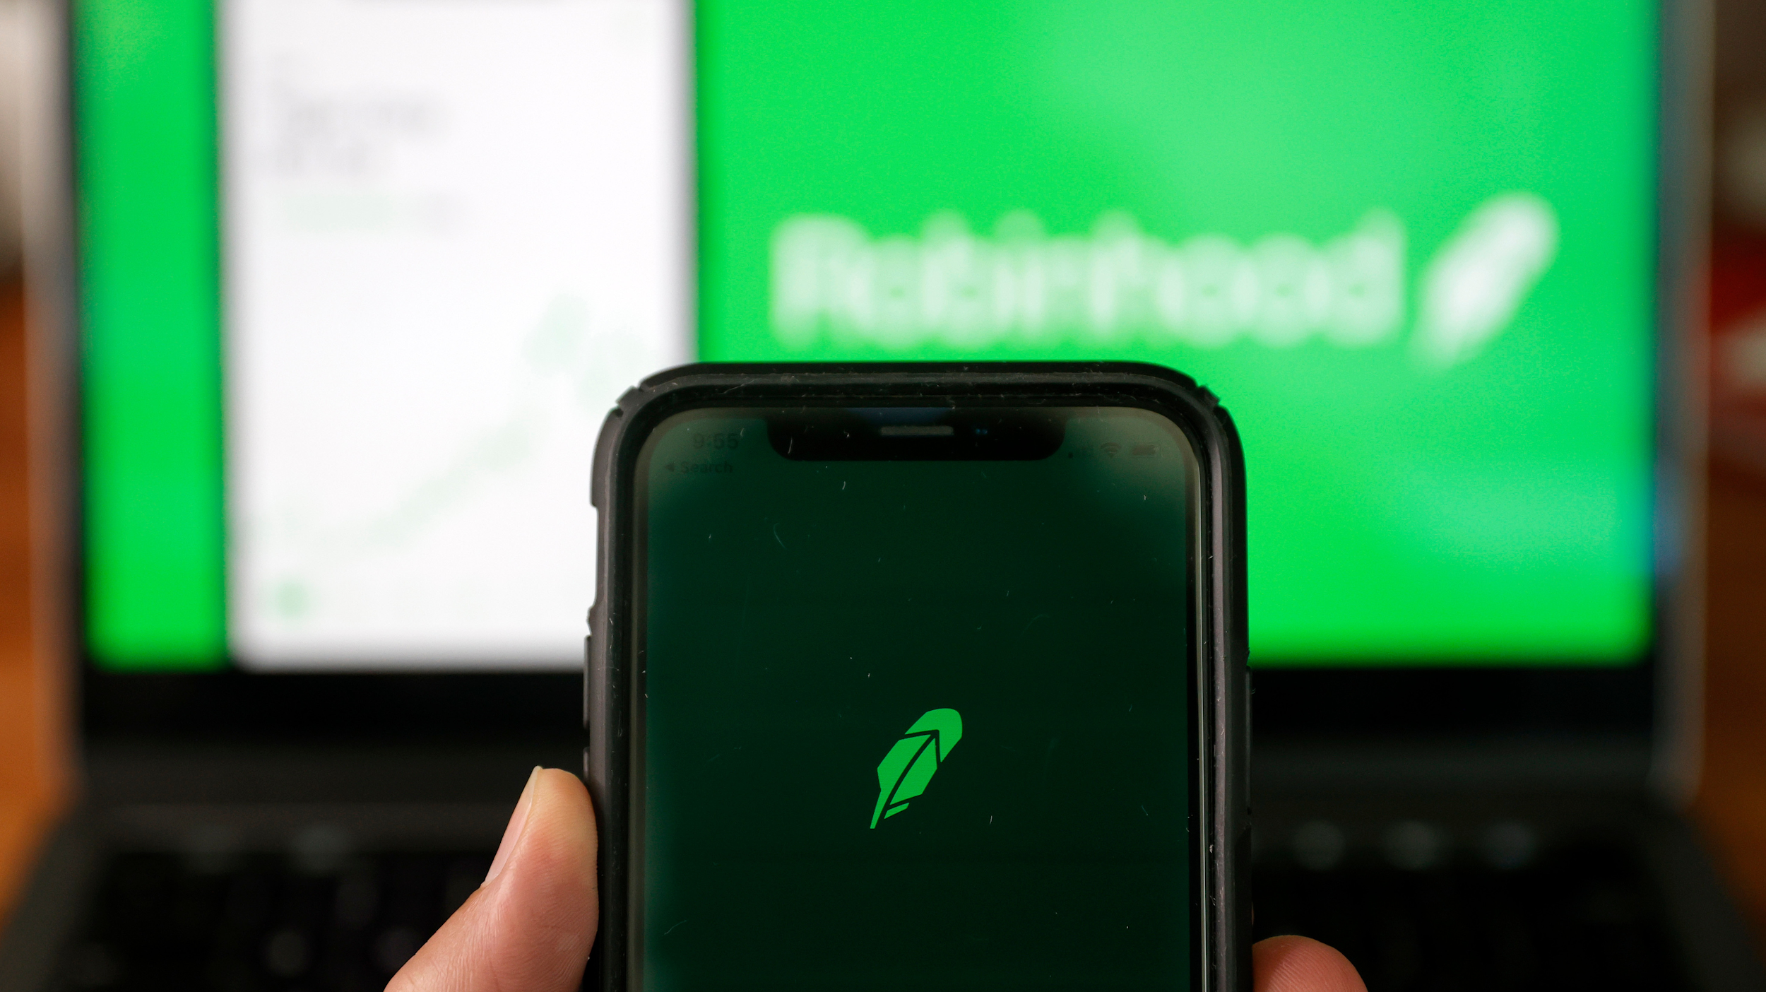
Robinhood’s mission...
“Robinhood’s mission is to democratize finance for all. We believe that everyone should have access to the financial markets, so we’ve built Robinhood from the ground up to make investing friendly, approachable, and understandable for newcomers and experts alike.”
Photo: Justin Sullivan (Getty Images)
Notes:
I pulled this from their website. For those of us who are not familiar with Robinhood, it’s basically an app that lets users--theoretically anyone with a bank account-- start investing in the stock market among other things.
They promise to democratize finance
And they have access to the financial markets as their goal.
It’s a really interesting idea. One that really opens up wealth (and sometimes loss) generation to everyone.
If you’ve been paying attention to the news over the past few months, you’ve probably heard of them. It’s very likely that you’ve heard their name in conjunction with Reddit and Gamestop.
Let’s take a look at what happened there.

Slide 7
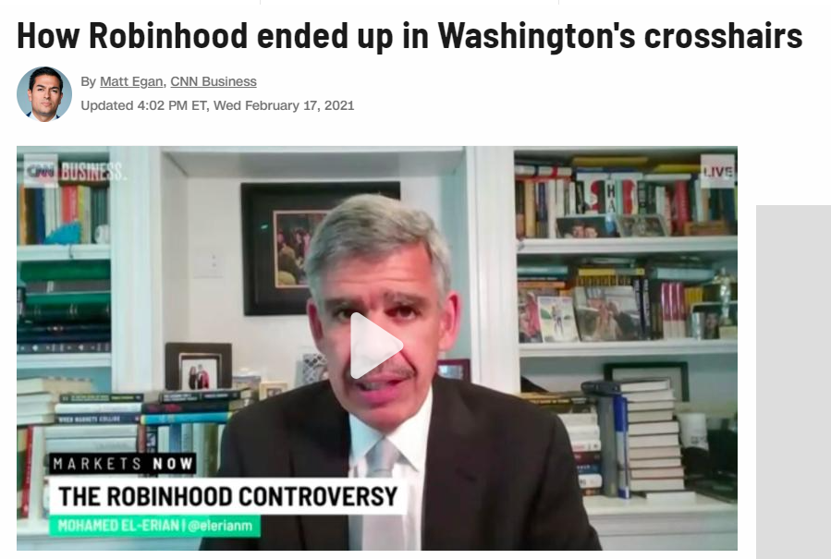
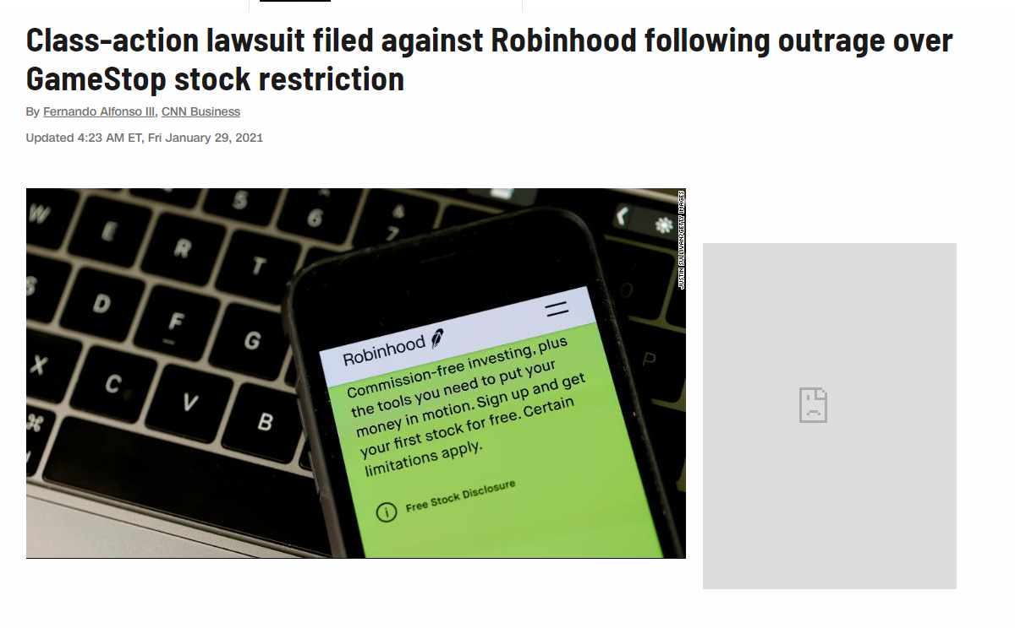
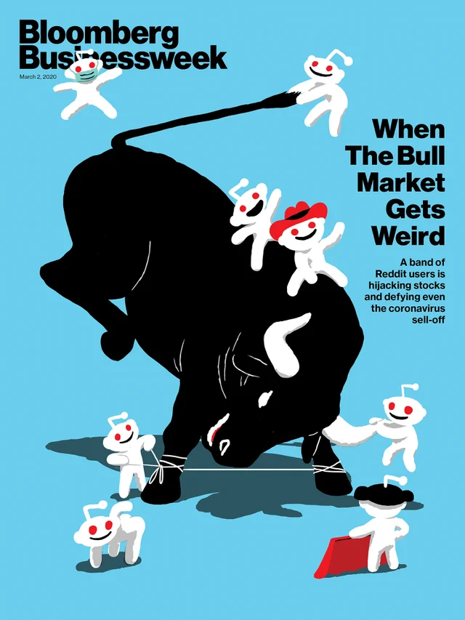
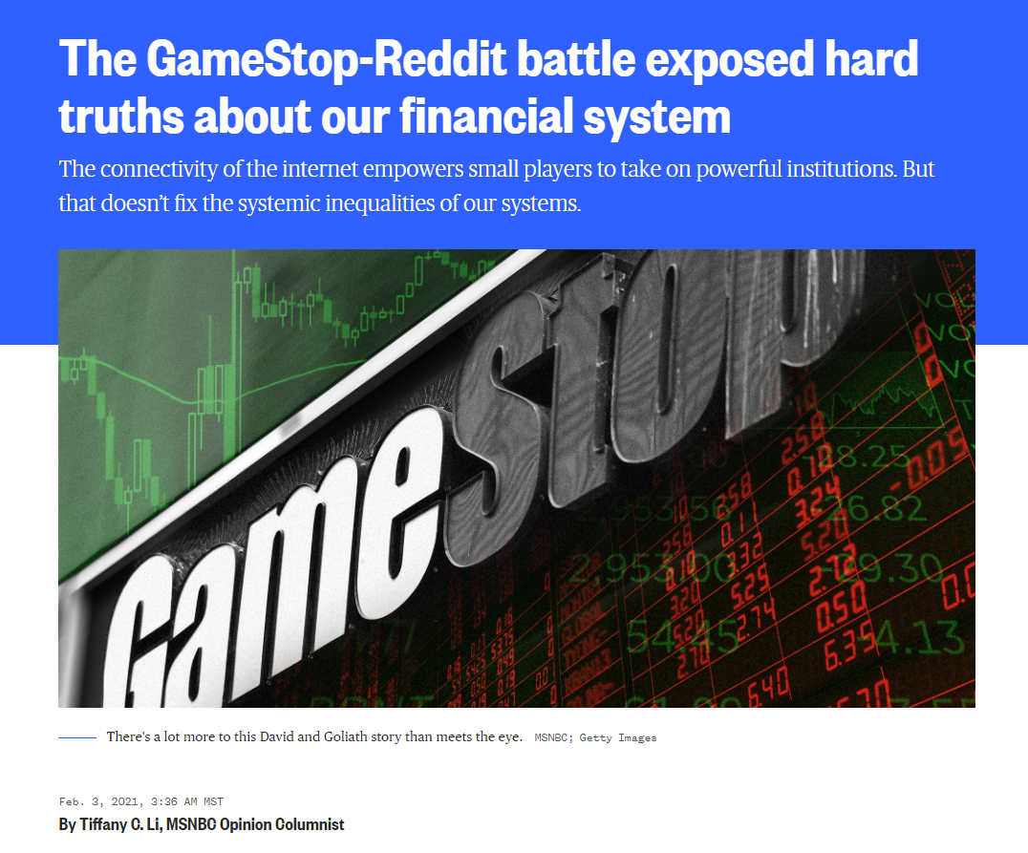
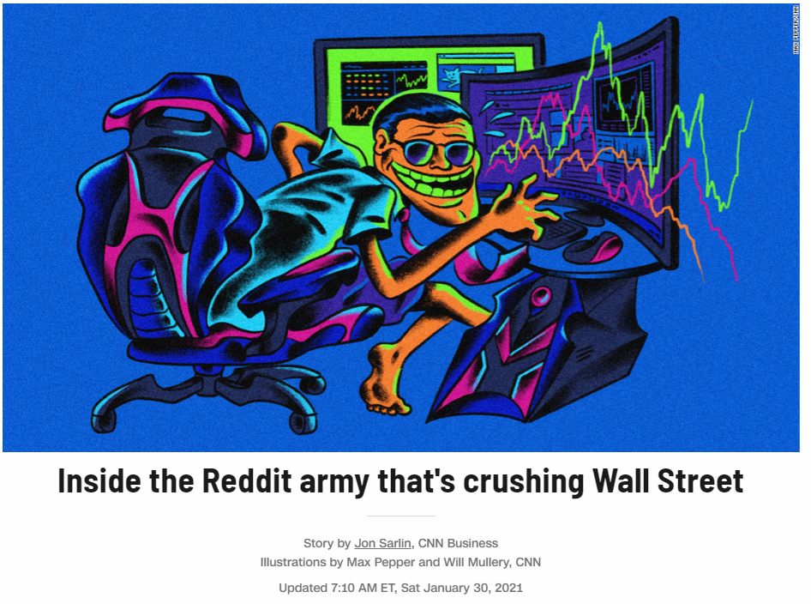
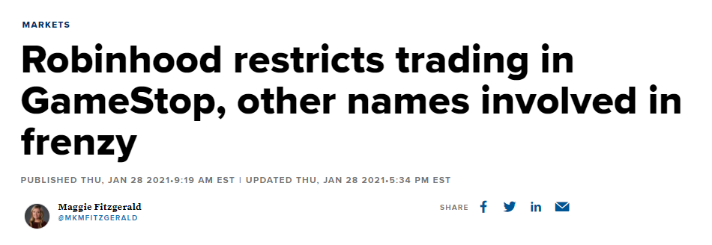
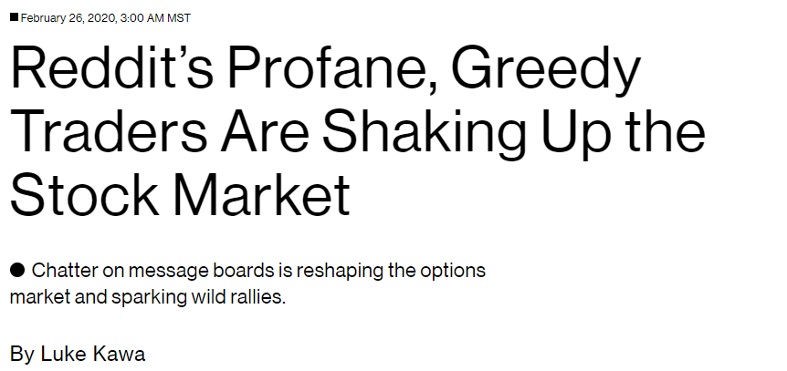
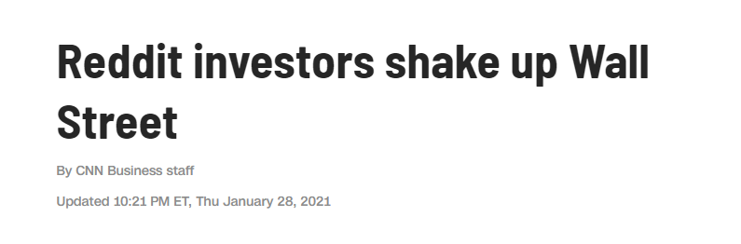
r/WallStreetBets + $GME + Robinhood
Notes:
Let’s start just by flashing some of the relevant headlines to give us a gist of the story.

Slide 8
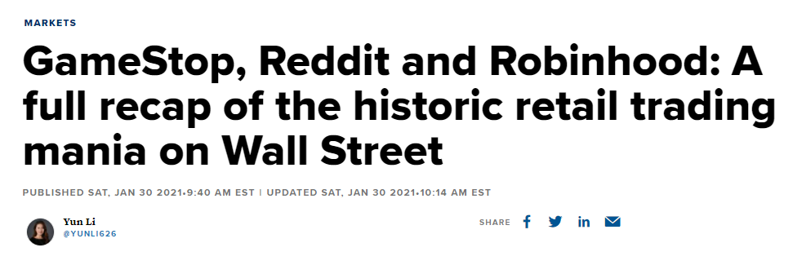
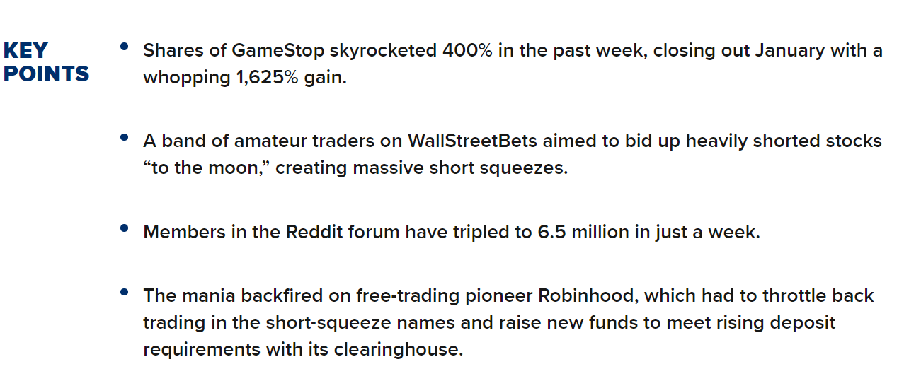
r/WallStreetBets + $GME + Robinhood
Source: CNN Markets
Notes:
No a quick summary.
Several traditional hedge funds were shorting stock for a company called gamestop. (They were betting that the price would go down).
An group of redditers in the WallStreetBets community noticed this and decided to conduct a short squeeze (drive the price up to their benefit and force those who were shorting stock to pay large sums of cash).
One of the primary tools they used was Robinhood (it allows users to buy stocks with low-to-no trading fees).
However the mania around this shortsqueeze backfired when Robinhood suspended trading of these stocks. Regardless of why they did this the perception was that they were protecting traditional wall street hedge funds (at least one of which is a sister company to them).
Yikes.

Slide 9
Robinhood (RH) as a Case Study
Let’s explore those same questions through the lens RH’s brand:
How well does RH’s branded Twitter account stand out?
How did RH’s decisions impact the (inferred) sentiment of their user base?
How can we make sense of r/WallStreetBets reddit data as it pertains to the RH brand?
Notes:
Let’s use this as the backdrop for our exploration of unstructured, text data.
Well try to answer the following questions:
How well does RH’s branded Twitter account stand out?
How did RH’s decisions impact the (inferred) sentiment of their user base?
How can we make sense of r/WallStreetBets reddit data as it pertains to the RH brand?

Slide 10
Brand Voice Differentiation
Notes:
Looking at Robinhoods twitter account is really asking questions around brand voice and how differentiated their brand voice is relative to competitors.

Slide 11
We’ll create a “voice print” based on how frequently a brand uses certain words and then compare “voice prints” between brands.
Notes:
To approach this, We’ll create a “voice print” based on how frequently a brand uses certain words and then compare “voice prints” between brands.

Slide 12
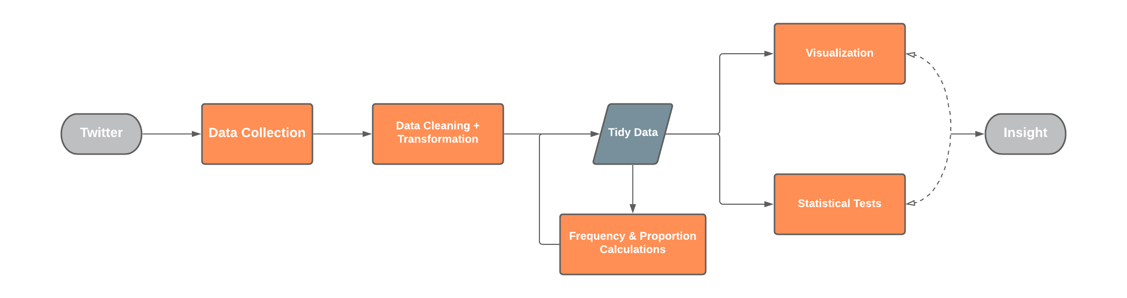
Brand Voice Differentiation | Approach
Notes:
This is what our process looks like. You can do this with 100% open source tools and a bit of programming knowledge (that was my path and I”m happy to share my code with you!) or if you’re team has social listening tools, you can lean on them for this kind of analysis.
Most importantly though, were going to collect data from twitter, the 2500 most recent tweets by each brand, clean it up, and then use a correlation test and some visuals to make sense of it.

Slide 13
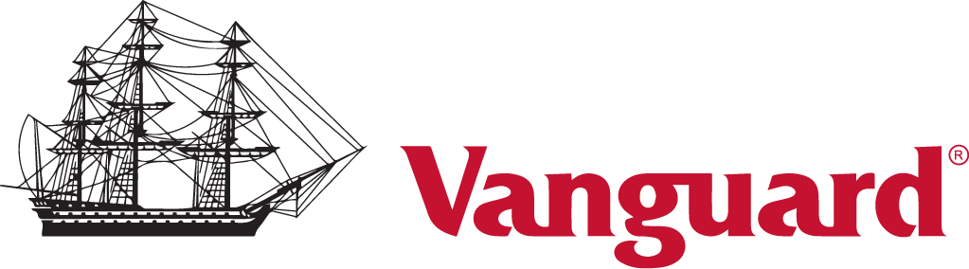

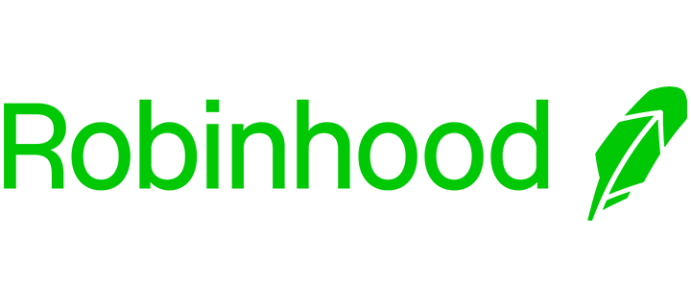

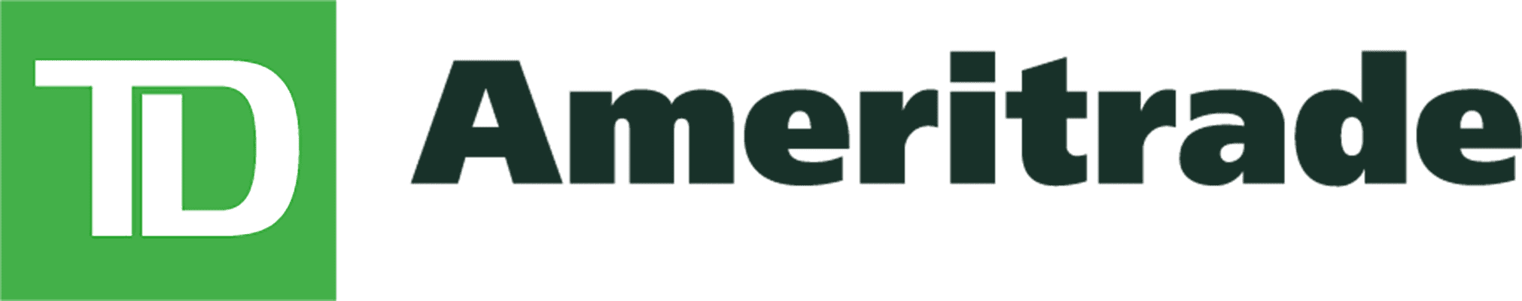
Brand Voice Differentiation | Competitive Set
Notes:
Here is the competitive set we’ll be looking at for this analysis. Three of these brands are pretty well established and may be considered more traditional.
Robinhood and Webull are more upstarts/disruptors in this space.

Slide 14


A Note on Correlation
Source: What is a Correlation Coefficient? The r Value in Statistics Explained
Notes:
A quick note on correlation:
Correlation, simply put, is a measure of how related two variables are. If two variables were directly related (perfectly correlated) we’d express assign them a correlation coefficient of either 1 or -1 depending on the direction of their relationship.
We can see that in our first example, there doesn’t seem to be a strong relationship between hypothetical weight gain over the past month and a person’s test scores.
We can visualize that relationship bty trying to draw the smallest ellipsis around most of our data and see what it tells us.
**Click**
Unsurprisingly there isn’t much of a relationship here. If we were to quantity this correlation we’d probably say it is close to 0 (meaning no strong relationship in either direction).
Looking at how much someone eats and how satisfied their hunger is, we can already intuit that there should be a strong relationship here.
**Click**
Using that same ellipsis technique we can see we get a longer, narrower ellipsis, something that suggests a much stronger relationship.
If we were to quantity this correlation we’d expect it to be closer to 1 (meaning a strong positive relationship (as one variable increases so does the other)).

Slide 15
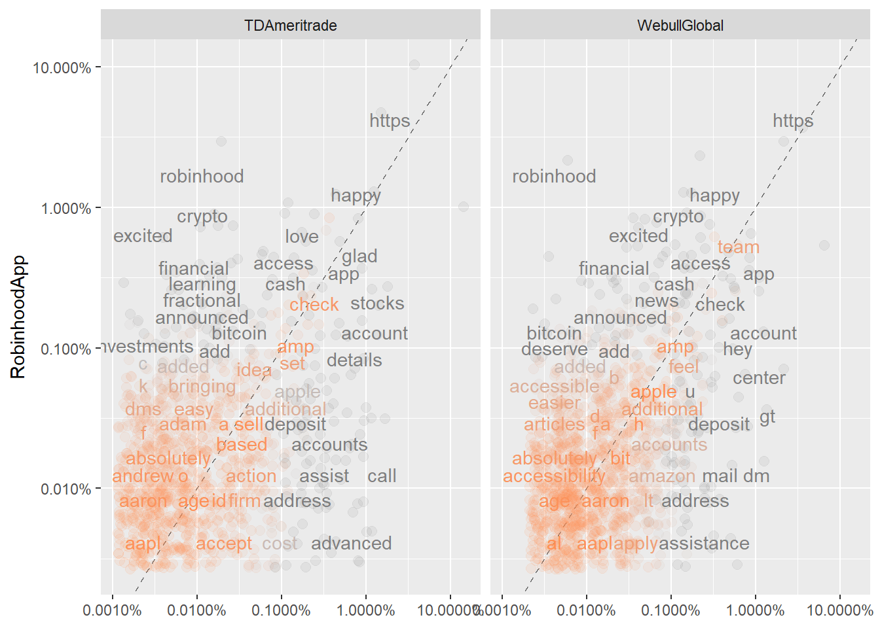
Brand Voice Differentiation | Term Frequency & Correlation Tests
Frequently used by RH
Frequently used by TDAmeritrade
Notes:
Let’s apply what we just learned about correlation to brand voice differentiation.
Here we’ve taken the frequency with which Robinhood uses certain terms and plotted it along the Y axis and the frequency which with TDA Ameritrade uses those same words and plotted them along the x asis.
Words that are close to this diagonal line (and colored in orange) are words that are used with similar frequencies by both twitter accounts
You can see words like Robin hood and crypto are more frequently used by robinhood than their competitor. Where as words like “Check, Idea, and Action” are used by both firms similarly.
Let’s layer another competitor in here (WeBull) and take a look.

Slide 16
Brand Voice Differentiation | Term Frequency & Correlation Tests
Cor = ~0.36
Cor = ~0.64
Notes:
Now let’s apply our circle trick one more time.
**Click** Here we can see that there is a positive relationship but this ellipsis is kind of wide or stout.
**Click** If we copy that same shape over to Webull
**Click** you can see that we’d be able to tighten it up and still encompass most of the data points.
This suggests that the relationship is stronger and the brand voices of these two competitors are likely more similar.
Quantifying that, we’d expect the correlation coefficient for Robinhood and Webull to be closer to 1.
**Click**
And we can see that this plays out as we’d expect.
Let’s take this a step further and look at the whole cohort together.

Slide 17
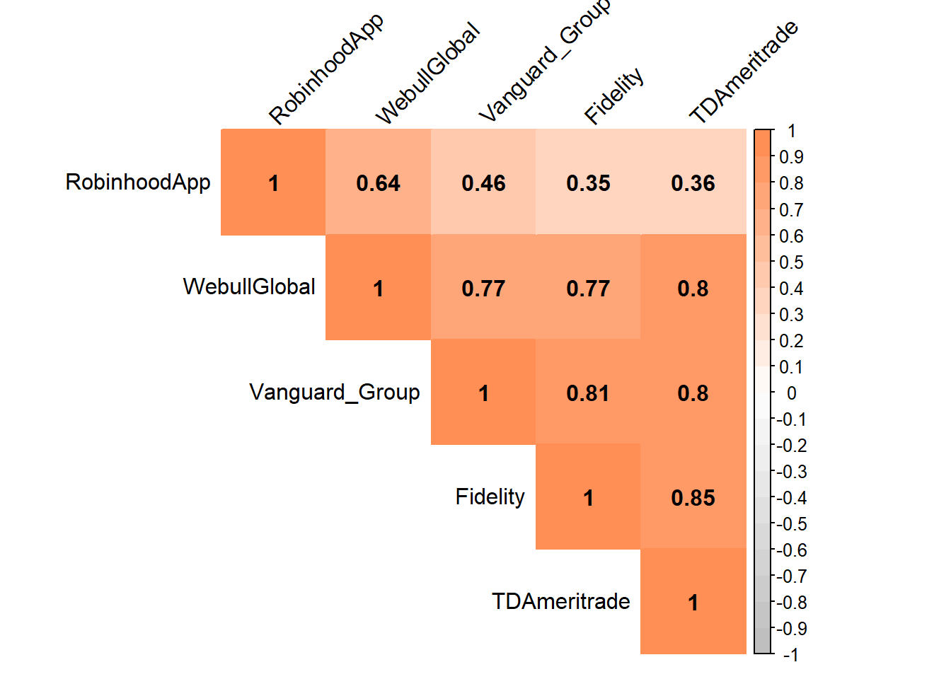
Brand Voice Differentiation | Correlogram (Comparing Our CompSet)
Notes:
Here, we’ve conducted the exact same analysis for each of these twitter corrects and measured how similar they each are to one another.
**Click** What do you notice about Robinhood relative to its competitors?
We can see that webull is close but, robinhood appears to have the most unique voice among this cohort. That’s good new for them !
**click** what do you notice about webull?
Their brand voice, by this measure, is pretty similar to everyone, It seems to be the result of an amalgamation of all of these these other brands.
This may be a result of Webull being a challenger brand to both Disruptors like Robinhood and more established institutions.
**Click** unsurprisingly you can see that the more traditional companies have very similar brand voice. The financial industry is heavily regulated and these brands seem to be struggling to stand out on brand voice alone.

Slide 18
Brand Voice Differentiation | So What?
What does all of this mean for Robinhood?
Robinhood has a relatively differentiated brand voice.
Robinhood has a clear competitor in WeBullGlobal.
Next Steps for Robinhood:
Further differentiate from their nearest competitor
Defend their user base against WeBullGlobal
Notes:
So what does this mean for Robinhod?
Relative to the CompSet we considered, Robinhood has done a good job of differentiating their brand voice.
They have a clear competitor in WeBullGlobal that appears to be communicating in ways which have the potential to resonate with Robinhood’s audience.

Slide 19
Sentiment Analysis
Notes:
We’ve looked at brand voice their twitter data. Let’s start to look at the sentiment that a segment of their user base has for their brand by digging into brand mentions of Robinhood in the r/WallStreetBets community on reddit.

Slide 20
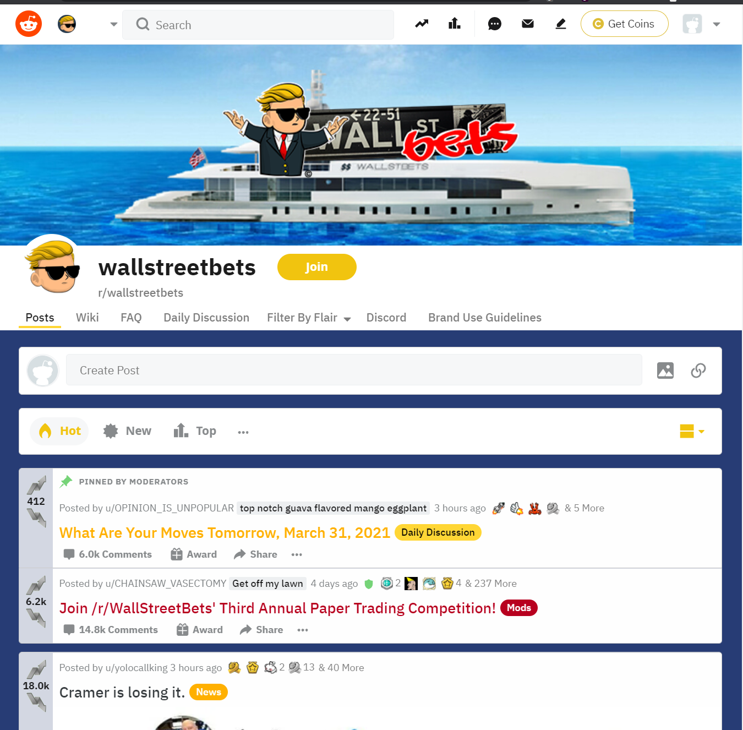
Sentiment in r/WallStreetBets
Notes:
A subreddit is just a forum where folks with a similar interest congregate online and have discussions, share information, and sometimes, plan activities.
This is the homepage of the r/WallStreetBets community. It’s pretty evident that they seem to have what i’ll generously describe as “personality”

Slide 21
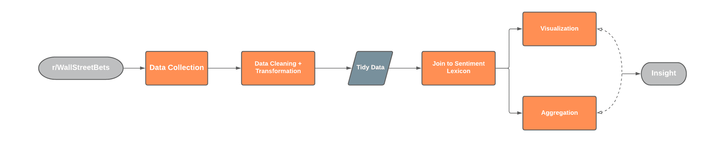
Sentiment Analysis | Approach
Notes:
This is what our process looks like. Once again, you can do this with 100% open source tools or if you’re team has social listening tools, you can lean on them for this kind of analysis.
This time, were going to collect data from reddit (the 100 most popular posts and all of their comments, about 45 thousand in total), clean it up, and then conduct a sentiment analysis with it that will help us make sense of this online conversation much more quickly than we could if we were to do this by manually reading all of the comments ourselves.
Before we jump in, let’s talk about how our sentiment analysis will actually work.

Slide 22
Sentiment Analysis | An Example
We were the best advertising for RH. We need to end that now RH has been on some real bullsh.t, that much is clear.
We were the best advertising for RH. We need to end that now RH has been on some real bullsh.t, that much is clear.
Notes:
This is a real comment from reddit. We are going to assign a positive or a negative tag to each word and then treat this comment as the sum of its parts. We can then aggregate those tags together into a sentiment score.
**Click**
Stated simple if a comment has lots of negative words in it, we’ll consider it a “net negative” comment and so on.

Slide 23
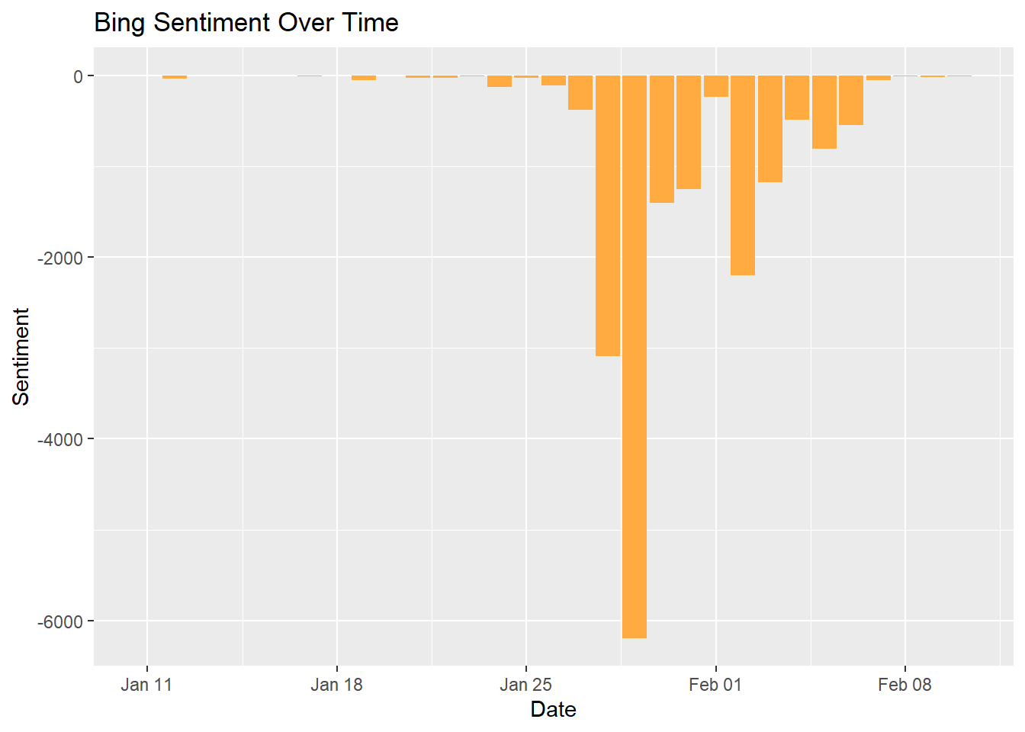
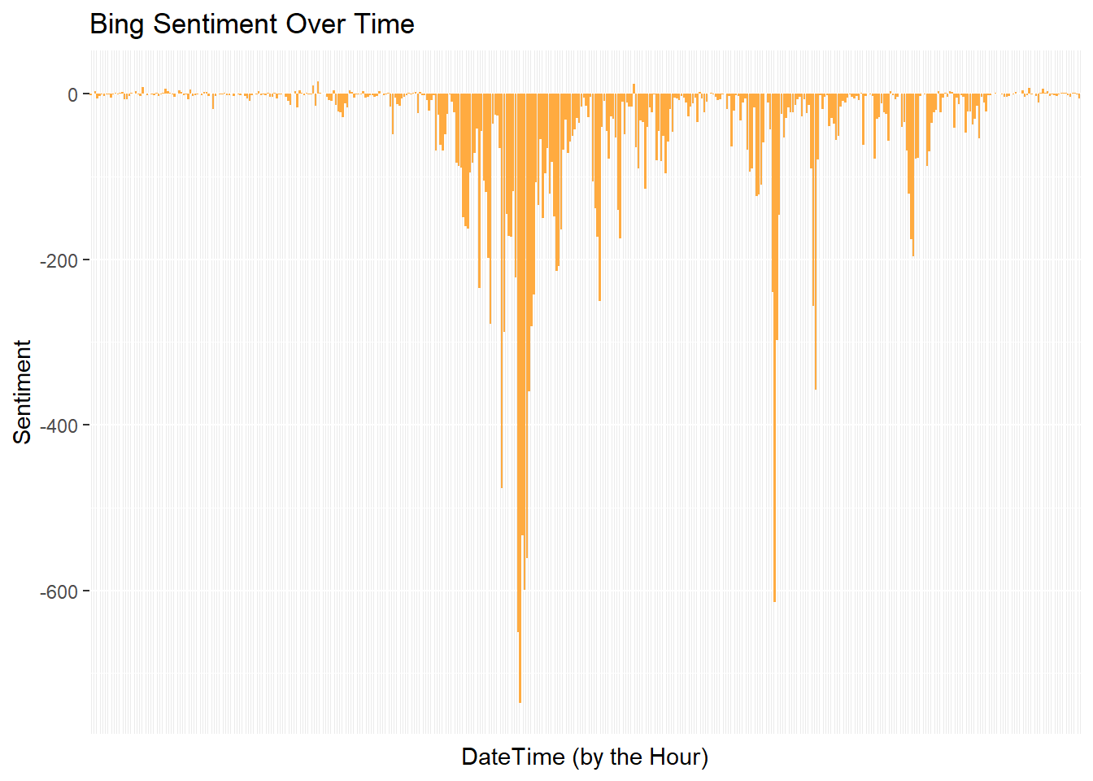
Tracking Sentiment Over Time
Jan 28
Jan 29
Notes:
Here, i’ve aggregated all of those sentiment scores by the hour.
**Click**
You can see at the very beginning there wasn’t a whole lot of activity around RobinHood. It’s pretty clear that something happens and what it is, clearly upsets this community.
It’s bit hard to make sense of this graph so, let’s roll everything up to the daily level.
**Click**
Here we can see that around the end of January, we see those deep negative spikes.
Think back to those headlines. What do you think could have trigger this?
** Pause **
**click**
Well you might remember that Robinhood restricted trading of Gamestop and other stocks during this time.
**Click**
Let’s check the publication date…
Jan 28
**Click**
Yep makes sense.
Know how people feel about our brands is important but if we can dig into what they are saying when they express that sentiment we may be able to glean additional insight.

Slide 24
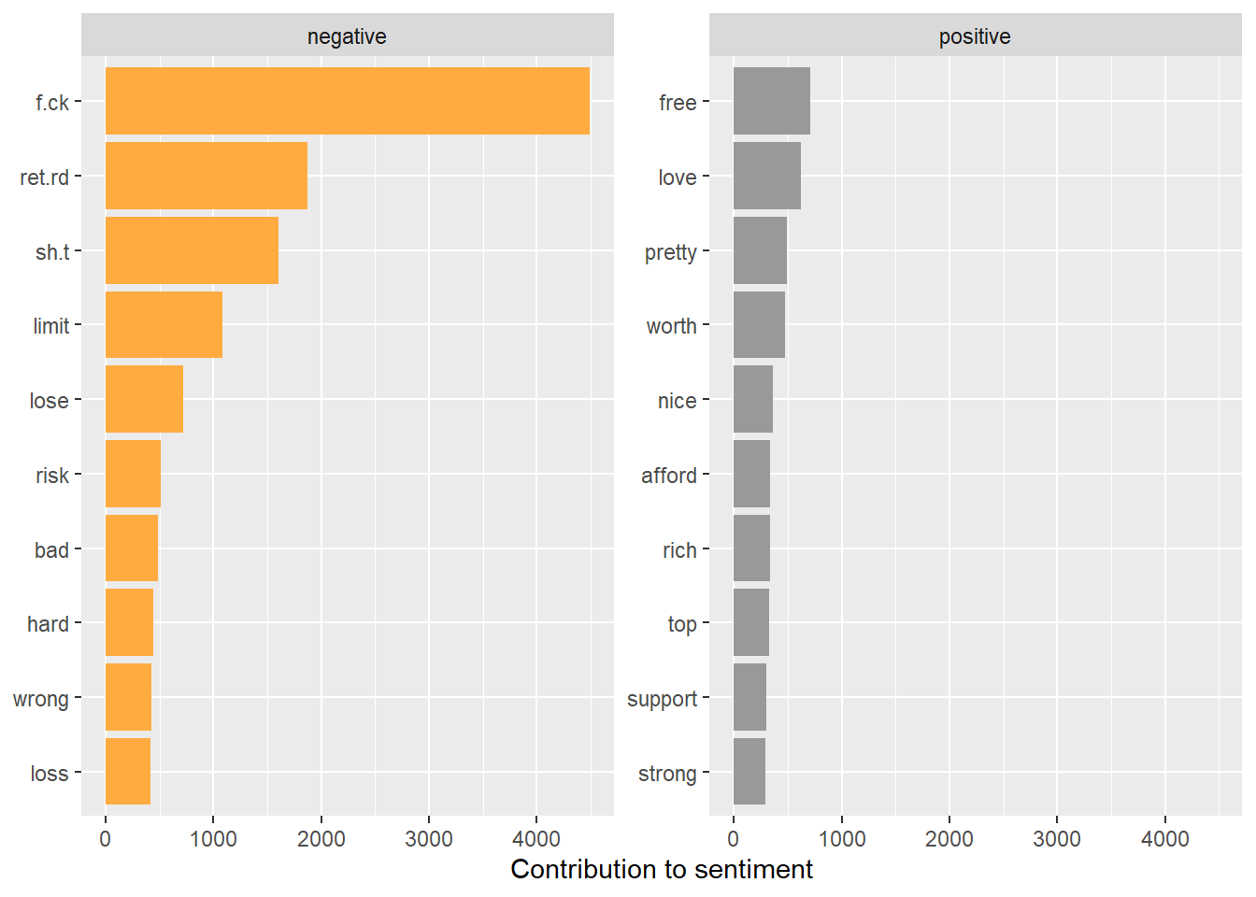
Term Frequency + Sentiment Contributions
Notes:
Here, i’ve gone back to the idea of term frequencies and ranked them by their relative contribution to sentiment.
This is helpful in that we can pretty quickly see that negative sentiment is overwhelming any of the positive terms that are at play here.
We can even see what might have upset the community.
Take a look at our 4th and 5th biggest contributors to negative sentiment, “limit” it may be that these redditors were upset that robinhood was limiting their ability to purchase stocks. And that was resulting in folks losing real money or perhaps perceived future gains that would have been associated with stock that they intended to purchase.

Slide 25
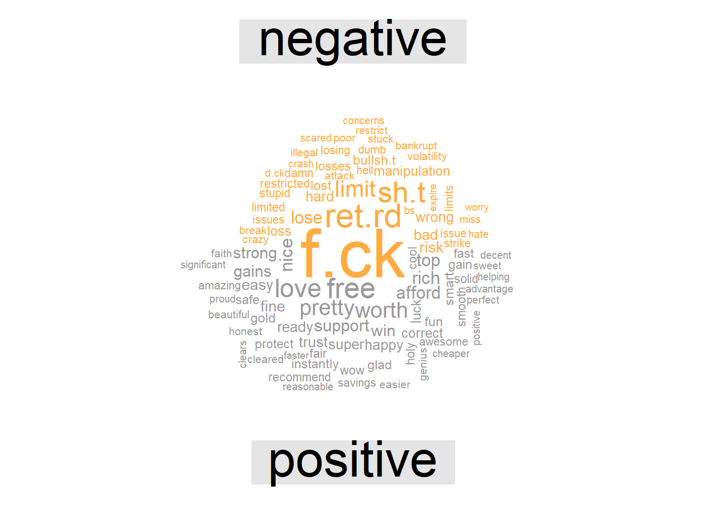
Term Frequency + Sentiment Contributions
Notes:
We can see that same information represented here, and it largely seems to support the conclusions we were starting to draw. If we resist the urge to be distracted by some of the more coarse language, we can see that words limit & restrict/restricted show up but we also surface new words like manipulation and illegal. Let’s dig into some of those ideas next.

Slide 26
N-Grams & Conversation Mapping
Notes:
We’ve used term frequency to help us explore these conversations so far. We can that a step further by using n-grams (or the co-occurrence of certain words or combinations of words) to further make sense of our data.

Slide 27
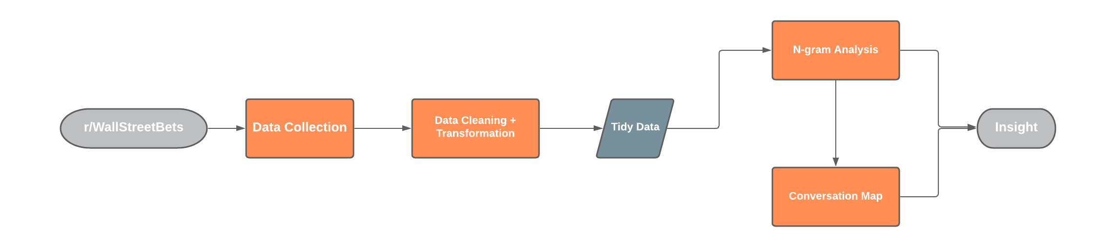
N-gram Analysis & Conversation Mapping | Approach
Notes:
This is what our process looks like. It’s very similar to what we saw previously expect his time, instead of focusing on sentiment, we’ll break phrase up into individual terms (unigrams) or two word phrases (bigrams) these are collectively called n grams where N is the number of terms in a group.
We can then use this to very quickly get the gist of a conversation online:

Slide 28
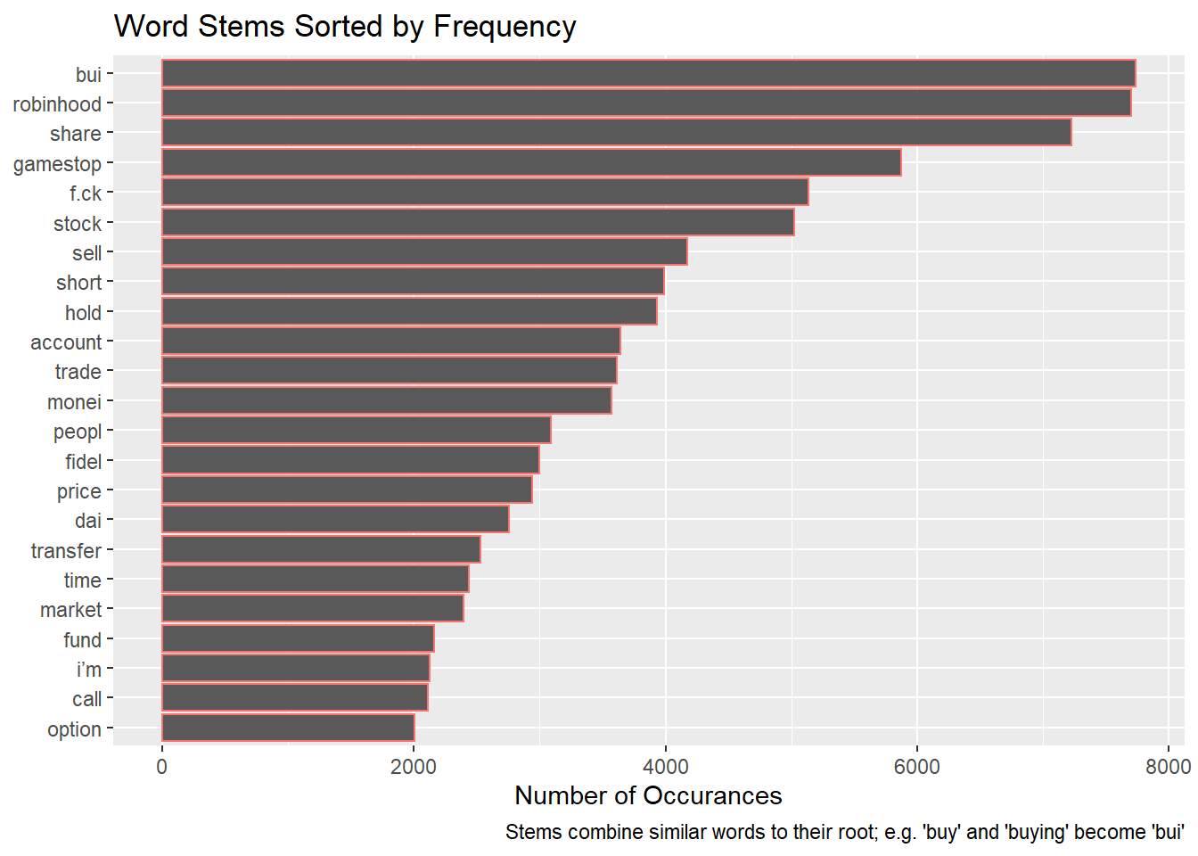
Term Frequency
Notes:
Let’s start with some unigrams or single terms “stemmed” or grouped together by their root. We can see that there are many terms that we’d expect to be very common. Words like Buy and Sell etc.
We can also see that “market” show ups. And that fidel the root for Fidelity (one of Robinhoods main competitors) also shows up very frequently. This should perhaps be alarming for Robinhood.
We can expand on this by looking at what words “surround” these most common terms by expanding into phrase analysis with bigrams.

Slide 29
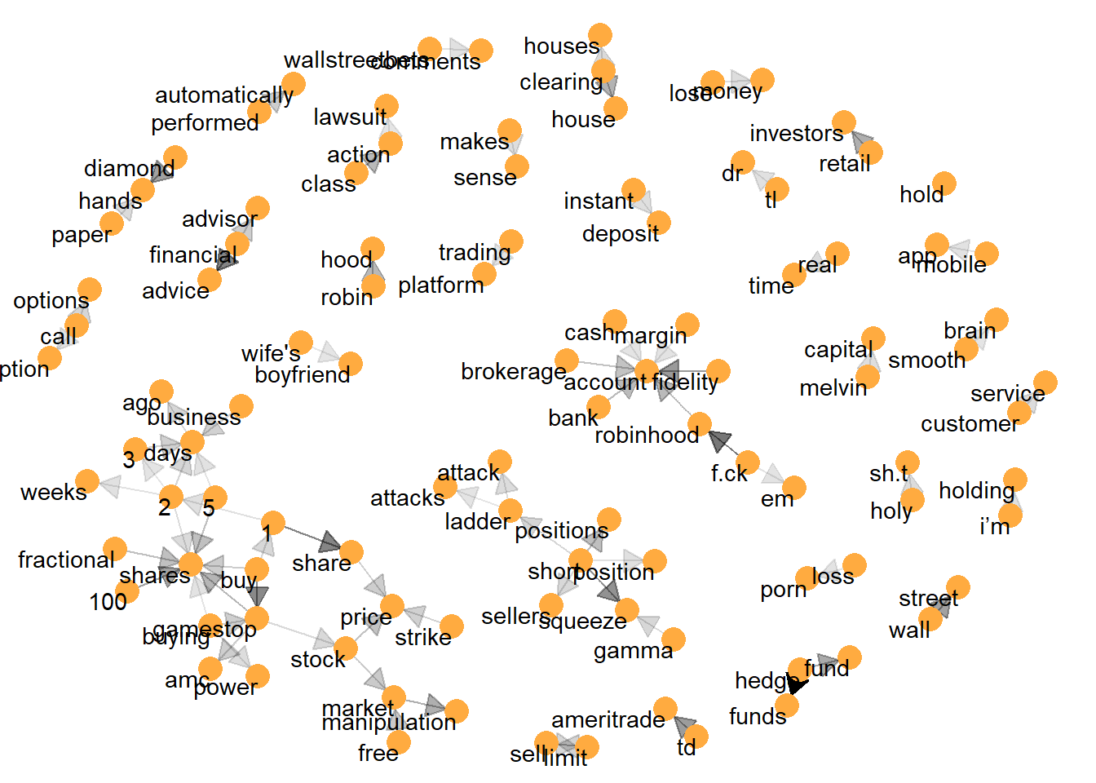
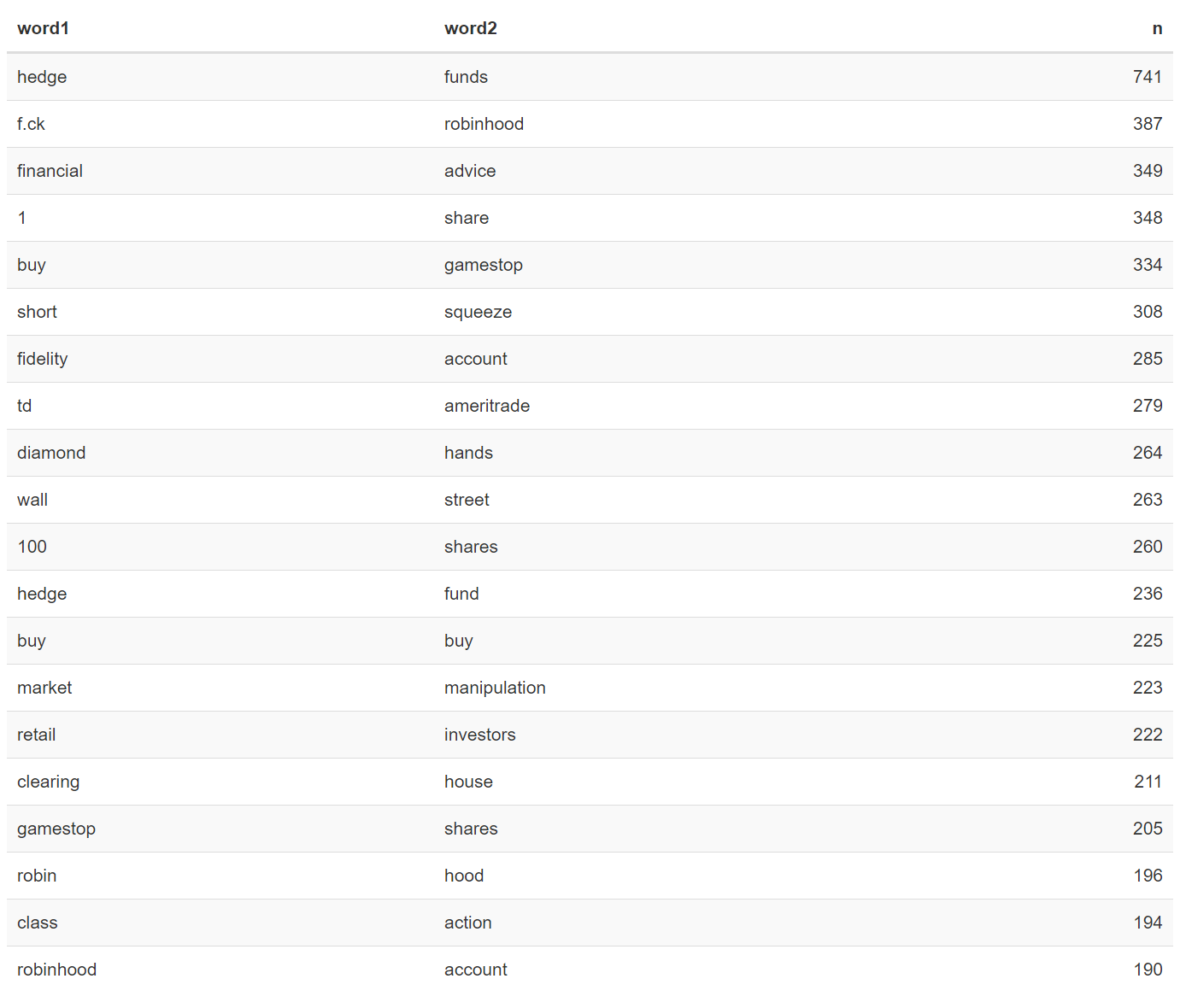
Going Beyond Single Words: N-gram Analysis
Notes:
I called out Market on the previous slide. And it wasn’t really that interesting. But here we can see that many occurrences of that term are associated with market manipulation. For any company that is subject to the SEC this is a pretty serious allegation.
We can visualize these phrases by using a network graph to cluster together words that appear together.
**Click**
IN looking at this graph, how quickly can you start to make sense of the whole conversation? It’s not perfect, but i’d wager that you clean more insight form this in just a seconds that you could by trying ot ingest all 45 thousand or so of these comments.
Let’s dig in a bit and look at some of these clusters.
**Click**
We can see some discussion around the technique that are play at the heart of this incident, short positions and the accompanying short and gamma squeezes.
**Click**
We can also see how frustrated folks were with Robinhood.
And finally we can see both the source of that frustration : perceived marketing manipulation, and the communities decided response, a class action lawsuit.
This tool becomes even more valuable when we pair with the raw comments. If we want to learn more about any of the topics in the conversation map, it’s trivial to filter our data set down to say… mentions of a competitor like fidelity and start to explore what our users are saying.

Slide 30
Sentiment Analysis and Conversation Mapping | So What?
What does all of this mean for Robinhood?
Robinhood violated its brand promise and upset its user base.
The network forces that turned against Robinhood were swift and startlingly one sided. RH failed to listen and paid the price.
Next Steps for Robinhood:
r/WallStreetBets does not represent 100% of the RH user base.
User discovery and a meaningful commitment to what users value must come next.
Notes:
What does all of this mean for Robinhood?
Robinhood violated its brand promise and upset its user base.
The network forces that turned against Robinhood were swift and startlingly one sided. RH failed to listen and paid the price.
Next Steps for Robinhood:
r/WallStreetBets does not represent 100% of the RH user base.
User discovery and a meaningful commitment to what users value must come next.

Slide 31
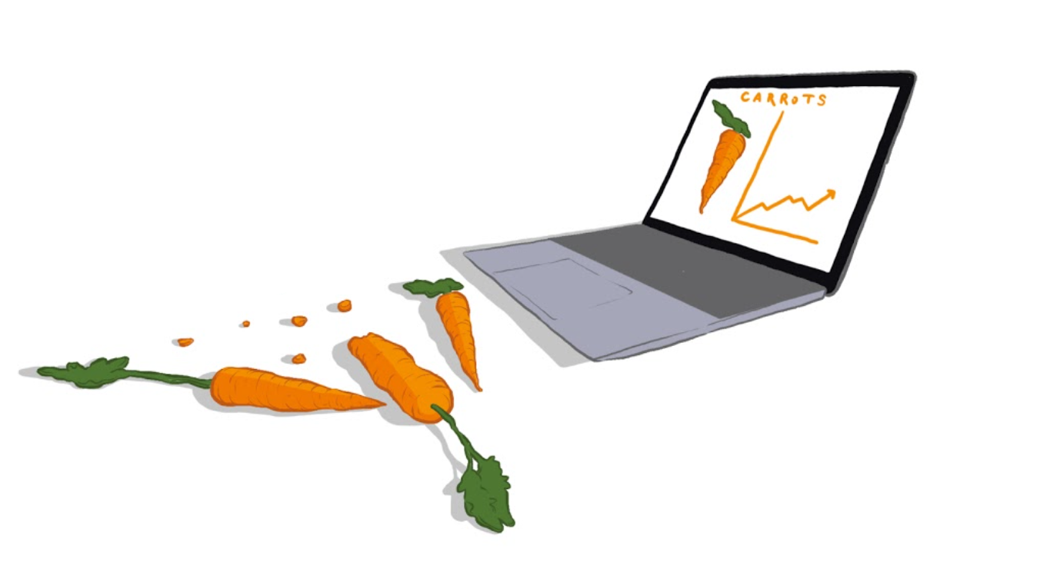
Questions?
Reach out on Twitter or LinkedIn
@alexanderhrose
Notes:
I hope i’ve inspired you to want to dig deeper into the unstructured data in which we are all (perhaps unknowingly) inundated. While there are many third party tools that can help you accomplish this (and based on your skill set that may be easier). I was able to do each of these analyses with open source options and a bit of programming knowledge. If you’d like to follow me down this path, reach out! I’d be happy to exchange ideas and share my toolset with you.
Thank you for your time i look forward to the forum Q and A

